Slide 1
Better Together
Evaluation Subgroup Update
July 19th, 2023

Slide 2
Evaluation Overview
Challenge: Scale
200M papers (100x bigger than OGB)
Training is expensive
Prediction can be hard (200M-1 negatives)
Scale should be preserved for evaluation (no tiny test sets)
Intrinsic Evaluation
Network effects and network nature of the papers
LM perplexity
Extrinsic Evaluation
Citation prediction
Notes:
Similarity uses title and abstract in current literature
Citation graph seems to work way better, will this get us somewhere
Hard to encode similarity with different authors who have different styles of writing
Model rot: Downstream tasks will degrade (e.g. model can’t propose recent papers it hasn’t seen
Focus on 2: intrinsic and extrinsic
Intrinsic: metcalfe’s law
Extrinsic: propose task
Literature focuses on text to measure similarity, explore whether context is better modality to encode similarity, combination?

Slide 3
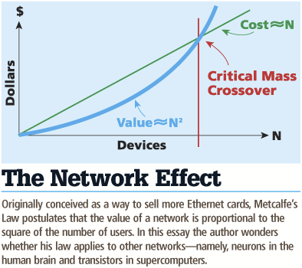
Network Effects: What is the Power of Scale?
Lack of focus on the network nature of papers
SciBERT = Text only
Specter, SciNCL = simple triplet loss
Doesn’t capture the potential power of the full network
Metcalfe's Law: cost scales in N, benefit scales in N^2
How great are the network effects for the citation graph?
Notes:
Graph (our problem) is network. Full effect only if everything is encoded at once, splitting a network is not effective because benefit scales
Literature only focuses on text similarity and few studies consider, going towards positive examples, pushing away from negatives (triplet loss). Consider small portion of citation graph and does not consider power of scaled graph. How can we use whole network in intrinsic evaluation?
Literature does not consider relationships between papers, only pairwise
Not the whole network, small dataset, within dataset, not whole 200m, time not considered

Slide 4
Network Effects: Data and Embeddings
Binning by time:
Split graph into 100 subgraphs by time
Cumulative graphs: each graph includes itself and all previous graphs
Embeddings:
Compute ProNE embeddings on cumulative graphs
Bin 99
………
Bin 0
Time
Notes:
mention equal # papers
consider replacing w/ diagram

Slide 5
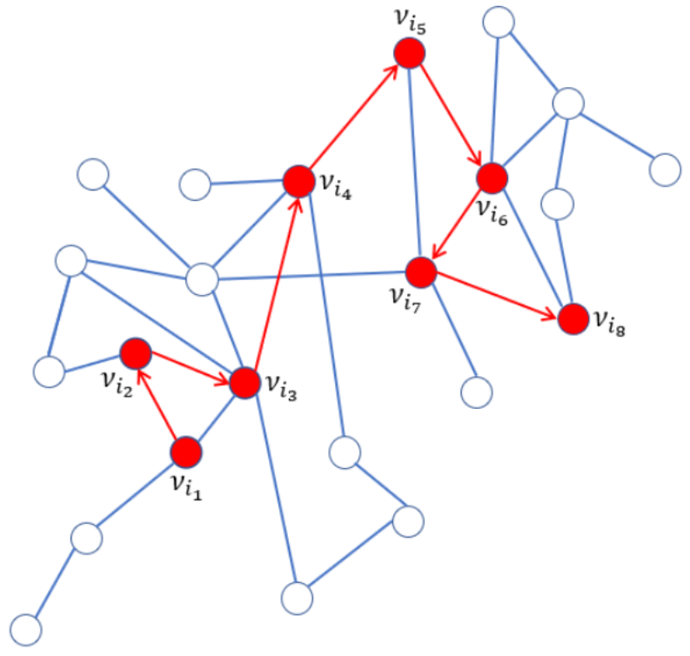
Network Effects: Random Walk
Pick random paper to start, extract all the references, walk to one of those references at random, and so on
There are often multiple paths to a paper – recorded number is the shortest path from starting paper
Limit to 1 to 4 hops away from query paper
Increasing # hops leads to decreasing similarity
Notes:
Evaluation task is predicting references in work, intrinsic eval can be random walk of citations
Use cosine similarity to measure similarity between pairs of papers

Slide 6
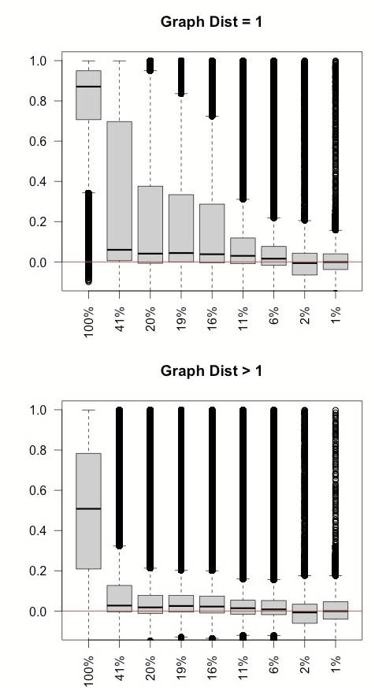
Network Effects: Results
Compare across ProNE embeddings
Find relationship between 1-hop (and 2-4 hops) proximity and cosine similarity within ProNE embeddings
Representation improves dramatically with increasing graph size
Cosine Similarity
Cosine Similarity
Percentage of Data Included (Bin)
Notes:
Time-intensive to generate these embeddings
check understanding of this slide

Slide 7
Extrinsic Evaluation – Local Citation Recommendation
Evaluation data
Keep maximum scale
12M papers S2ORC (https://github.com/allenai/s2orc)
Every citing sentence is a data point
Citation Recommendation
Classic task
Better together task
Note: Link prediction can refer to many things
Local Citation Recommendation with Hierarchical-Attention Text Encoder and SciBERT-based Reranking (https://arxiv.org/pdf/2112.01206.pdf)
Notes:
Refer to original paper before this. Link prediction refers to many things – earlier was one of simpler ones, whether i cites j. Introducing more complex problem
Reduce text
? answer, not q

Slide 8
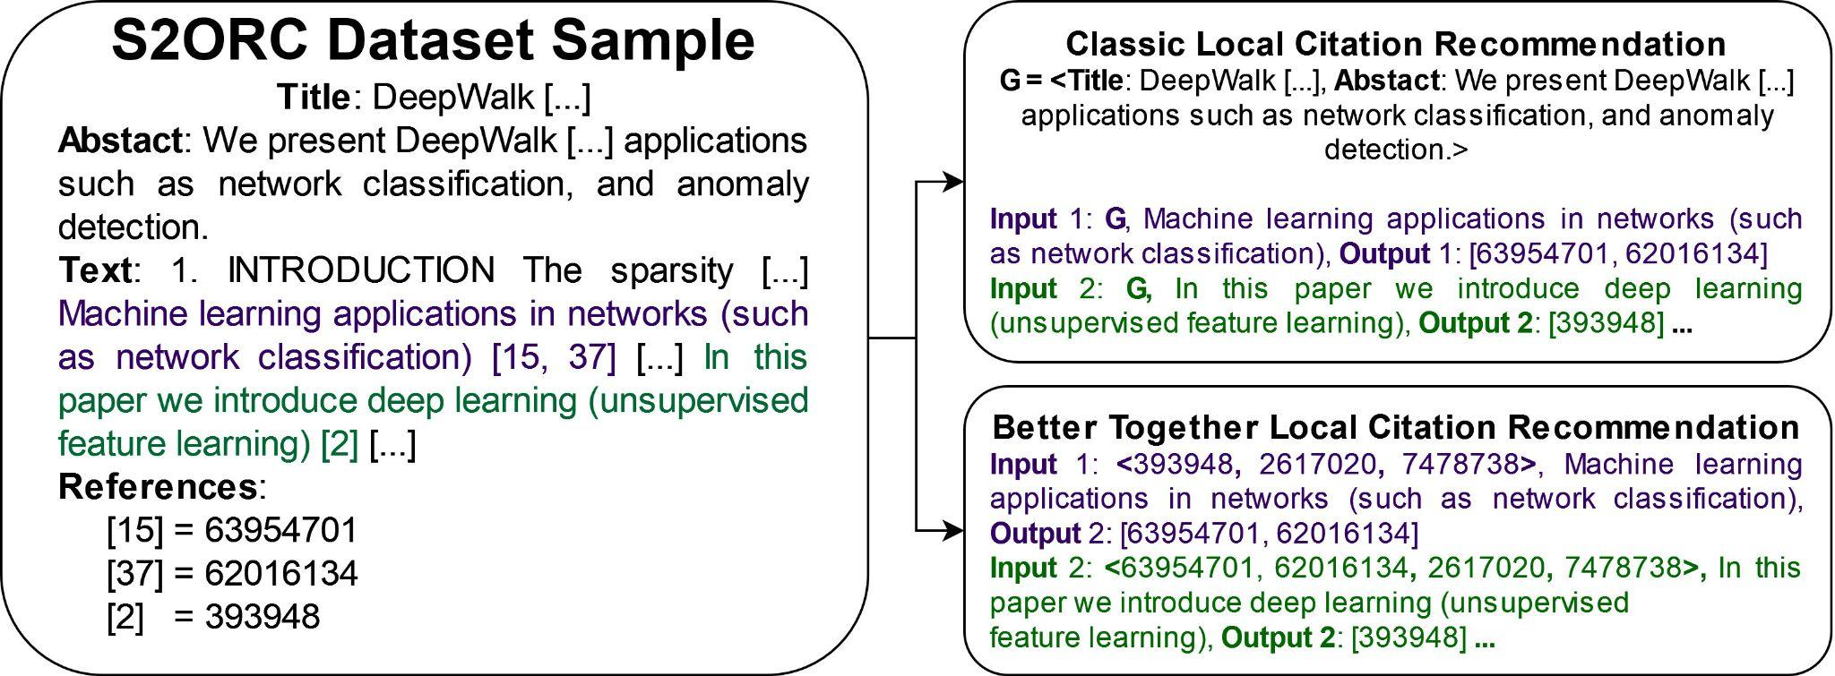
Extrinsic Evaluation – Local Citation Recommendation
Notes:
Refer to original paper before this. Link prediction refers to many things – earlier was one of simpler ones, whether i cites j. Introducing more complex problem
Reduce text
? answer, not q
use animations?
Emphasize task as predicting citations associated with citing sentence

Slide 9
Extrinsic Evaluation – Local Citation Recommendation
Notes:
Refer to original paper before this. Link prediction refers to many things – earlier was one of simpler ones, whether i cites j. Introducing more complex problem
Reduce text
? answer, not q
use animations?
Emphasize task as predicting citations associated with citing sentence

Slide 10
Extrinsic Evaluation – Local Citation Recommendation
Notes:
Refer to original paper before this. Link prediction refers to many things – earlier was one of simpler ones, whether i cites j. Introducing more complex problem
Reduce text
? answer, not q
use animations?
Emphasize task as predicting citations associated with citing sentence

Slide 11
Extrinsic Evaluation – Local Citation Recommendation
Notes:
Refer to original paper before this. Link prediction refers to many things – earlier was one of simpler ones, whether i cites j. Introducing more complex problem
Reduce text
? answer, not q
use animations?
Emphasize task as predicting citations associated with citing sentence

Slide 12
Extrinsic Evaluation – Local Citation Recommendation
Notes:
Refer to original paper before this. Link prediction refers to many things – earlier was one of simpler ones, whether i cites j. Introducing more complex problem
Reduce text
? answer, not q
use animations?
Emphasize task as predicting citations associated with citing sentence

Slide 13
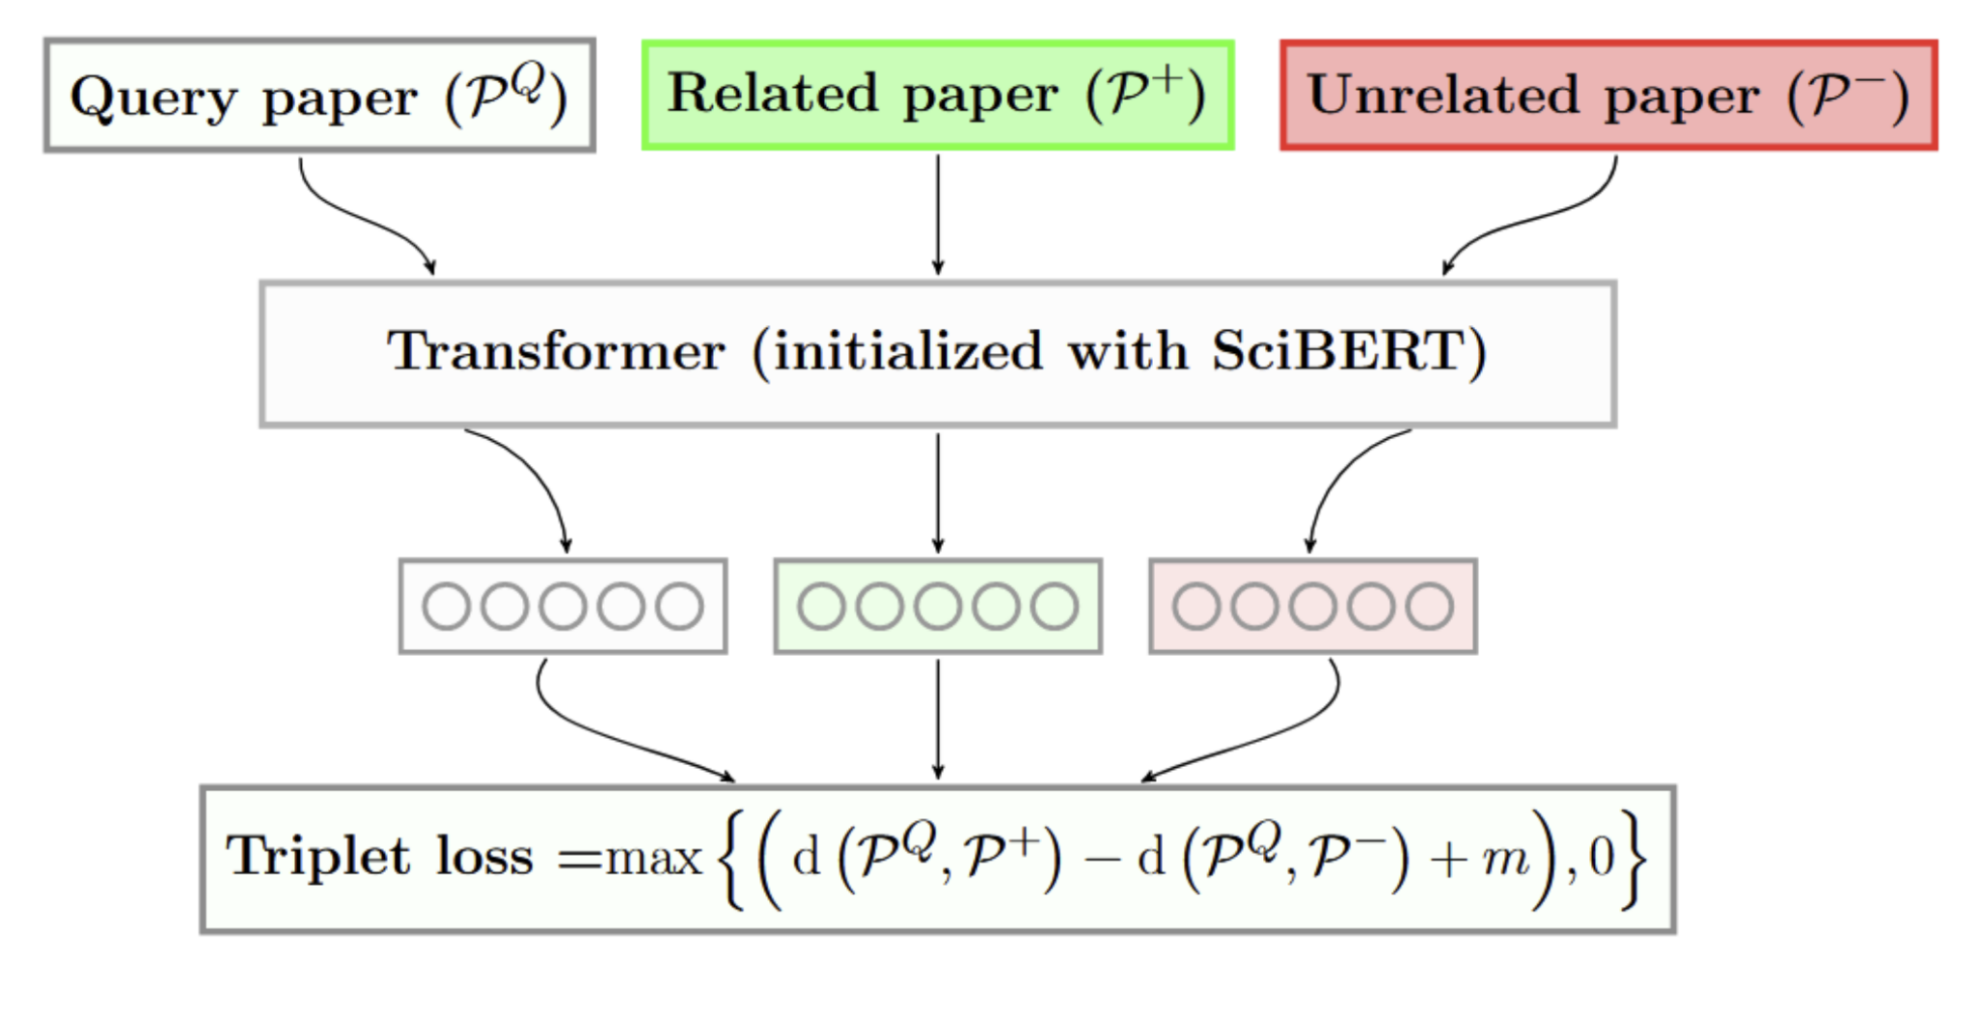
Evaluating text-based models
Text based document representation models rely on an underlying language model (Cohan et al., 2020)
SciBERT is a BERT-like model trained on text from scientific documents (Beltagy et al., 2019)

Slide 14
Perplexity as evaluation
Hypothesis: Perplexity is important. Document representation quality is related to the quality of the underlying language model
Language model perplexity is a measure of how “expected” a piece of text is to the model
So, we can use this measure as a signal of how well we would expect a model to represent a given document

Slide 15
How can we use this?
Evaluate how well the model can represent papers from different times in the past
Evaluate how quickly the model will “rot” past its training date
Find weak areas that the model can improve on

Slide 16
Perplexity for bidirectional models
BERT-style models do not have a well defined perplexity
Instead, use model scoring (Salazar et al., 2021) to calculate a pseudo-perplexity (per-subword)

Slide 17
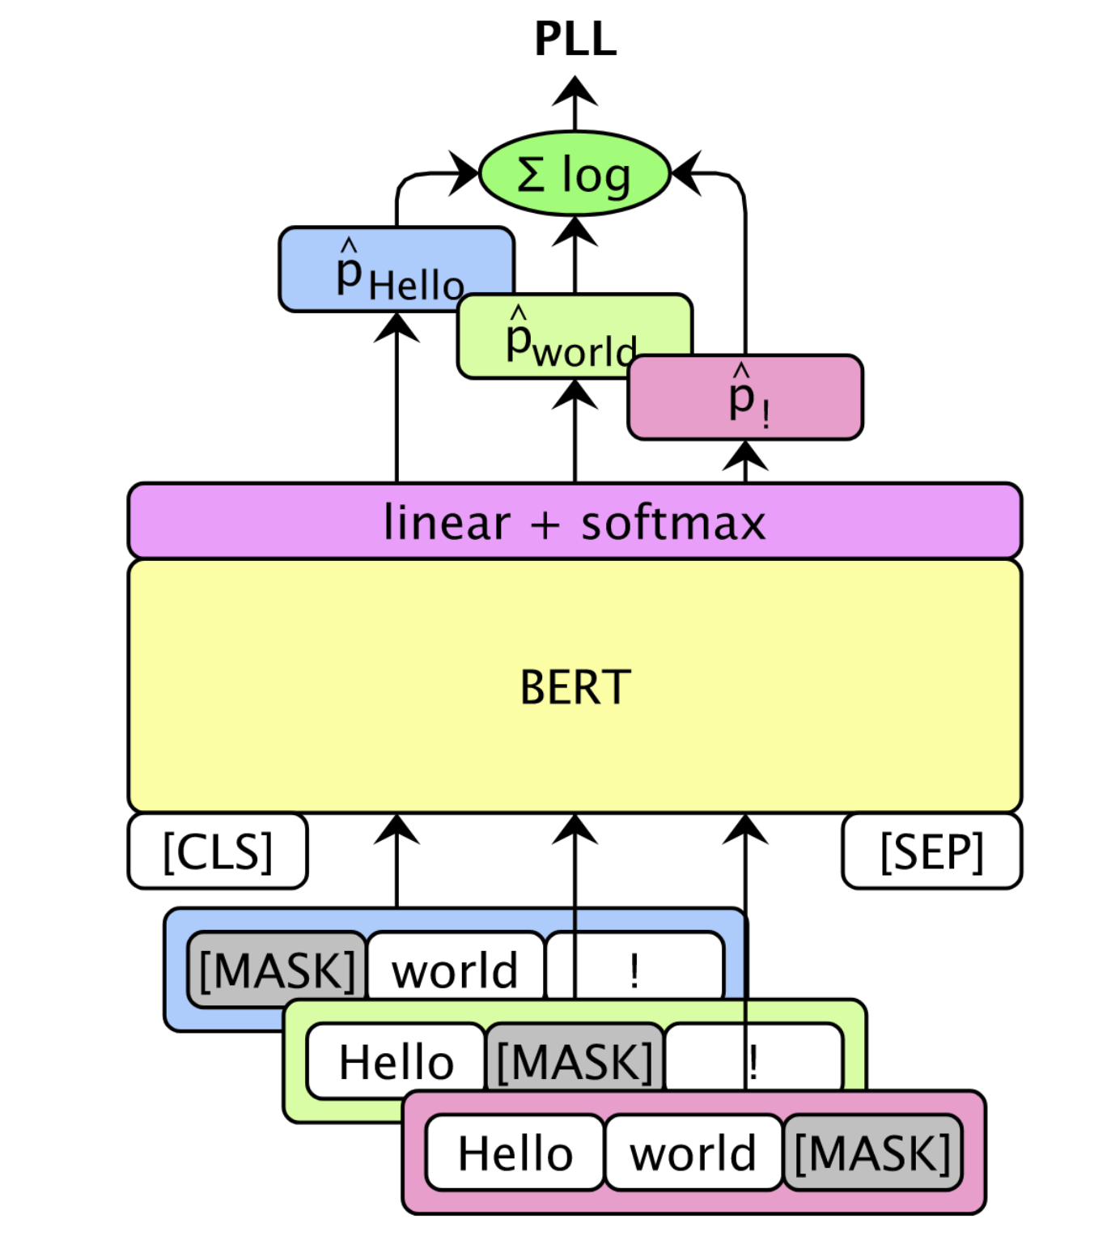
Pseudo Perplexity (PPPL)
BERT-style models do not have a well defined perplexity
Instead, use model scoring (Salazar et al., 2021)

Slide 18
Pseudo Perplexity (PPPL)
“peters pickled peppers”
[CLS]
pet
##ers
pick
##led
pepper
[SEP]
101
11109
1468
3368
2433
18700
102
log(p(pet))
∑ = PLL(w)
|V|
log(p(##ers))
log(...)
log(...)
log(...)
Pseudo log-likelihood
101
[MASK]
1468
3368
2433
18700
102
101
11109
[MASK]
3368
2433
18700
102
101
11109
1468
[MASK]
2433
18700
102
101
11109
1468
3368
[MASK]
18700
102
101
11109
1468
3368
2433
[MASK]
102
Notes:
BERT-style models do not have a well defined perplexity
Instead, use model scoring (Salazar et al., 2021)

Slide 19
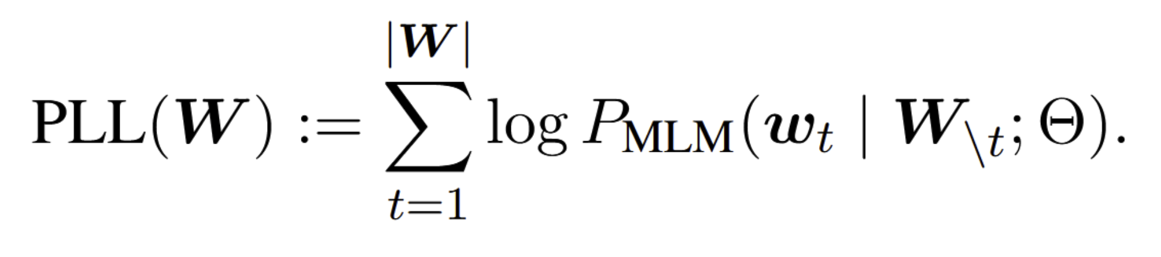
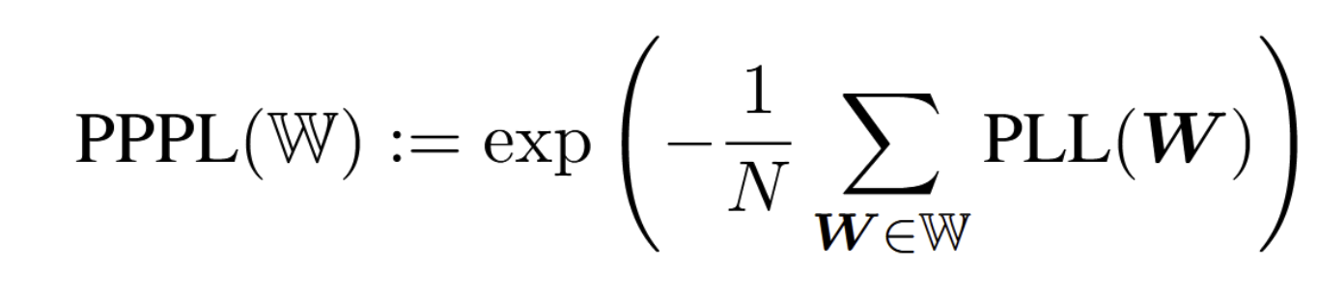
Initial Experiments
Sample 10,000 abstracts from each bin (no filtering)
Score the abstracts using the previous method
Abstract
# Tokens in Bin
Bin

Slide 20
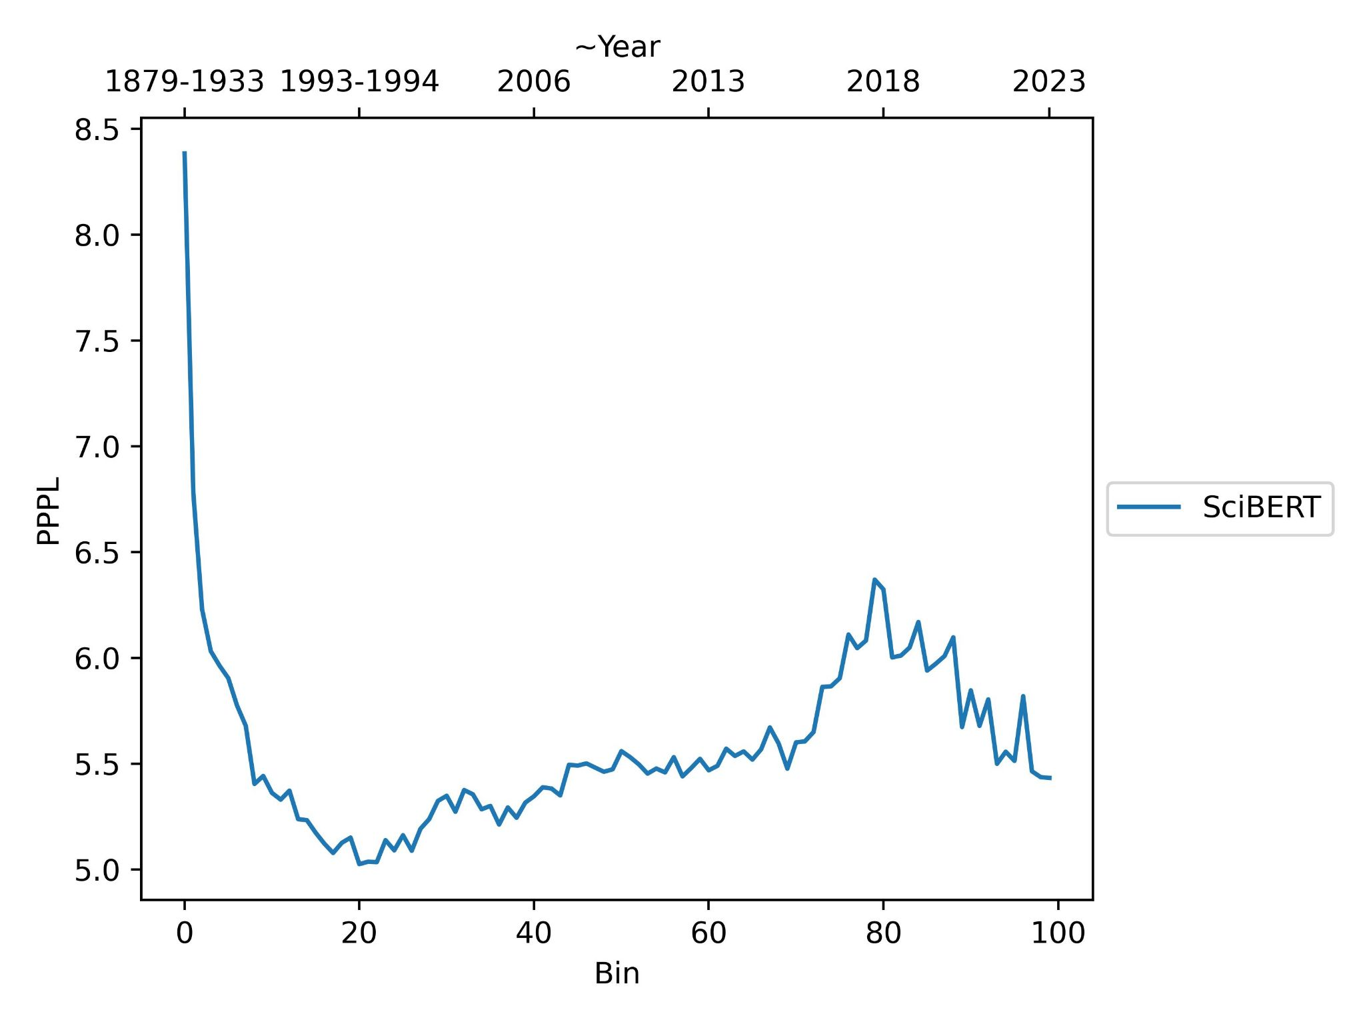
Past Analysis of SciBERT

Slide 21
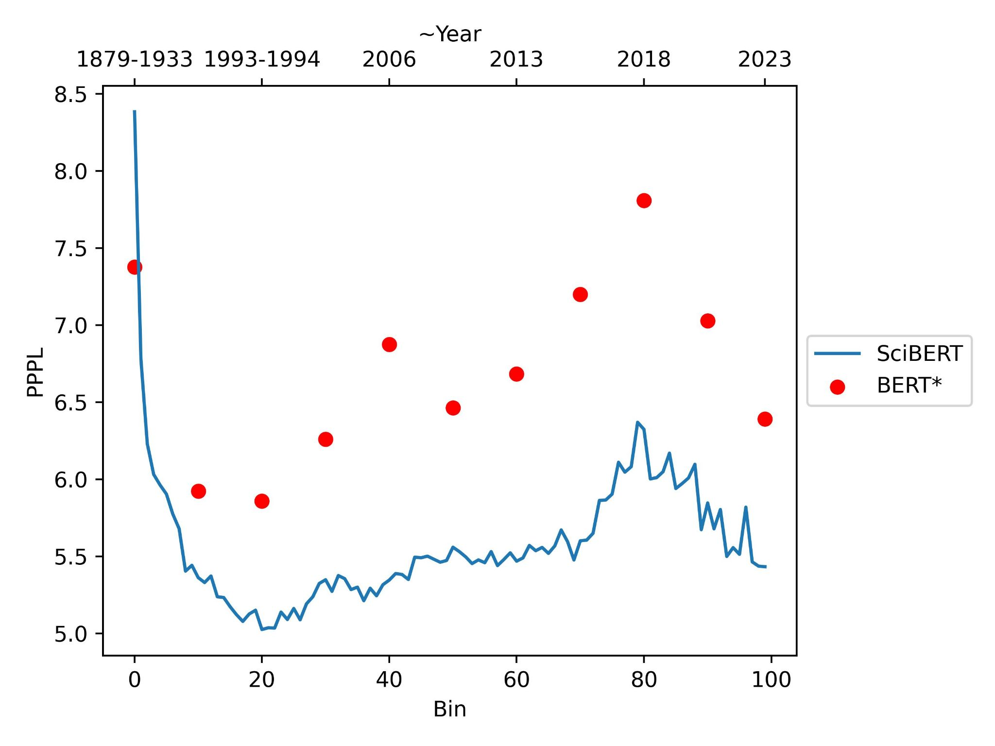
Past Analysis of SciBERT and BERT
500 samples

Slide 22
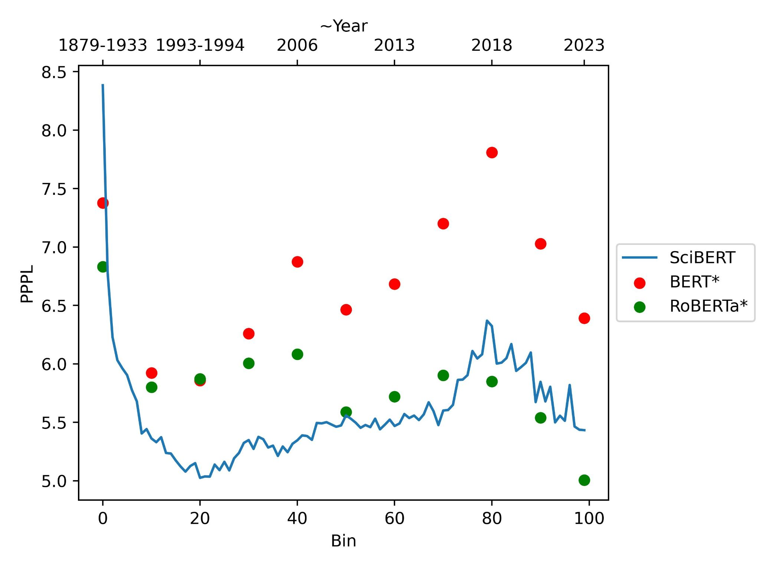
Past Analysis of SciBERT, BERT, and RoBERTa

Slide 23
Observations: Time Structure
Language model perplexity changes across time
These changes are predictable at least in the short term
BERT and SciBERT are more correlated compared to RoBERTa

Slide 24
Preliminary Results
Artifacts from the data or original model training:
Representative sample: earlier data is noisier
Some bins have a larger proportion of shorter abstracts
Sampling method when the model was trained?
Type of documents available for given years?
Artifacts of the field
Popularly used datasets for pretraining

Slide 25
Possible Implications
Our (scientific) language is getting more and more complex as time goes on, meaning language models not only need to be maintained, but maintenance will get harder and harder
One issue: any system which relies on a language model should probably check to see how well-suited it is to both the domain and time of the data being evaluated

Slide 26
Limitations
Re-sample focusing on clean data to evaluate the true language
SciBERT is not SPECTER
Need to take into account other factors which may inflate

Slide 27
Next Steps
Correlations with other measures: type/token ratios, fragmentation ratio, frequency of splitting, compression rates, number of unknown tokens, etc.
Re-sample with more consistent text
Statistical testing across bins
Stratifying by domain, language, etc.
Repeating across different domains and models

Slide 28
Summary
Observed a time structure in the LM perplexity of the data
Holds for multiple models which were trained on different datasets
Notes:
Maybe the performance between bin 80-100 is better because bin 20-40 is getting worse
Roberta has ~15% more parameters than BERT and ~13% more than SciBERT (due to vocabulary) {'scibert': 109971084, 'bert': 108340804, 'roberta': 124697433}

